Slide 1
RFID Attendance System
Project Presentation
PRESENTED BY
YARVA MAHESH

Slide 2
Introduction
RFID automates attendance using RFID tags, RC522 reader and Arduino Uno.

Slide 3
Objectives
• Automate attendance
• Reduce manual work
• Improve accuracy

Slide 4
Components
Arduino Uno
RC522 RFID Reader
RFID Cards
16x2 LCD
Green LED
Red LED
Buzzer
Power Supply

Slide 5
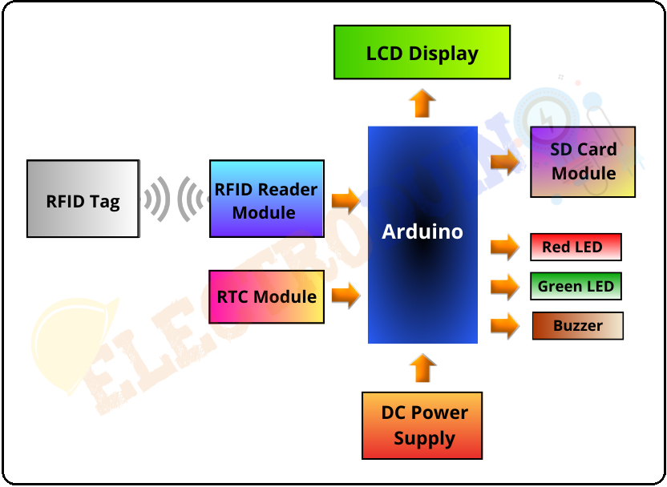
Block Diagram
RFID Card → RC522 → Arduino Uno → LCD / LEDs / Buzzer

Slide 6
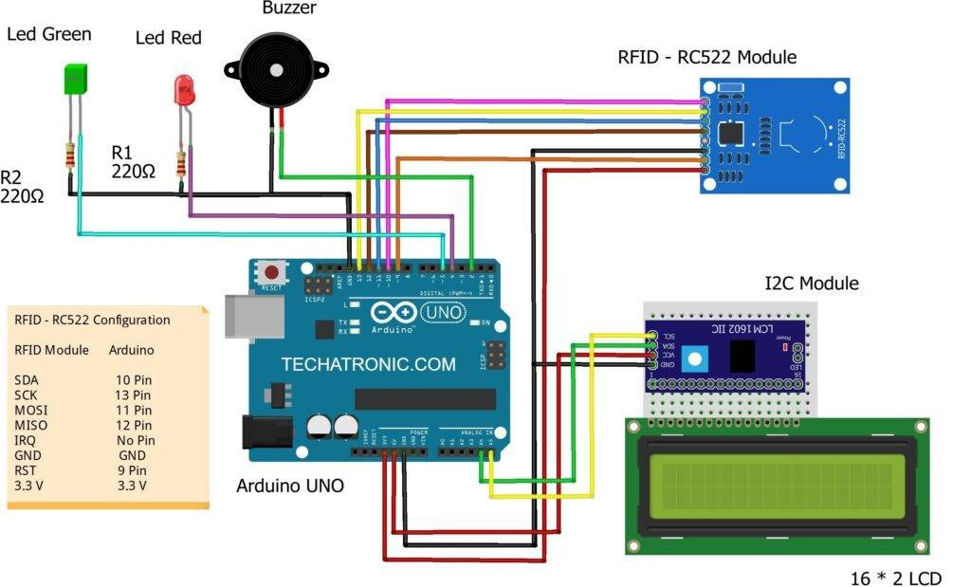
CIRCUIT DIAGRAM

Slide 7
Working
Scan card → Read UID → Compare UID → Valid: mark attendance & green LED
Invalid: red LED & buzzer

Slide 8
Applications
Schools
Colleges
Offices
Libraries
Industries

Slide 9
Advantages
Fast
Accurate
Paperless
Low Cost

Slide 10
Conclusion
RFID provides an efficient and reliable attendance system.

Slide 11


